Slide 1
Outline
Overview of existing literature
Fuller et al
Sept 2016 review
Methods overview
Emphasize distinctions form what they’ve seen
Meld review of what’s in the paper and what they have seen with how we responded to their recommendations
Initial high level results, eg several example communities 2020 only
Flagging how these fill gaps in ESR
Next deeper results, eg 2020 vs 2016-19 for a few important communities
Horizon pointing
MDS
Diff sp groupings, eg CVA high vs low ranks
Pre post catch shares

Slide 2
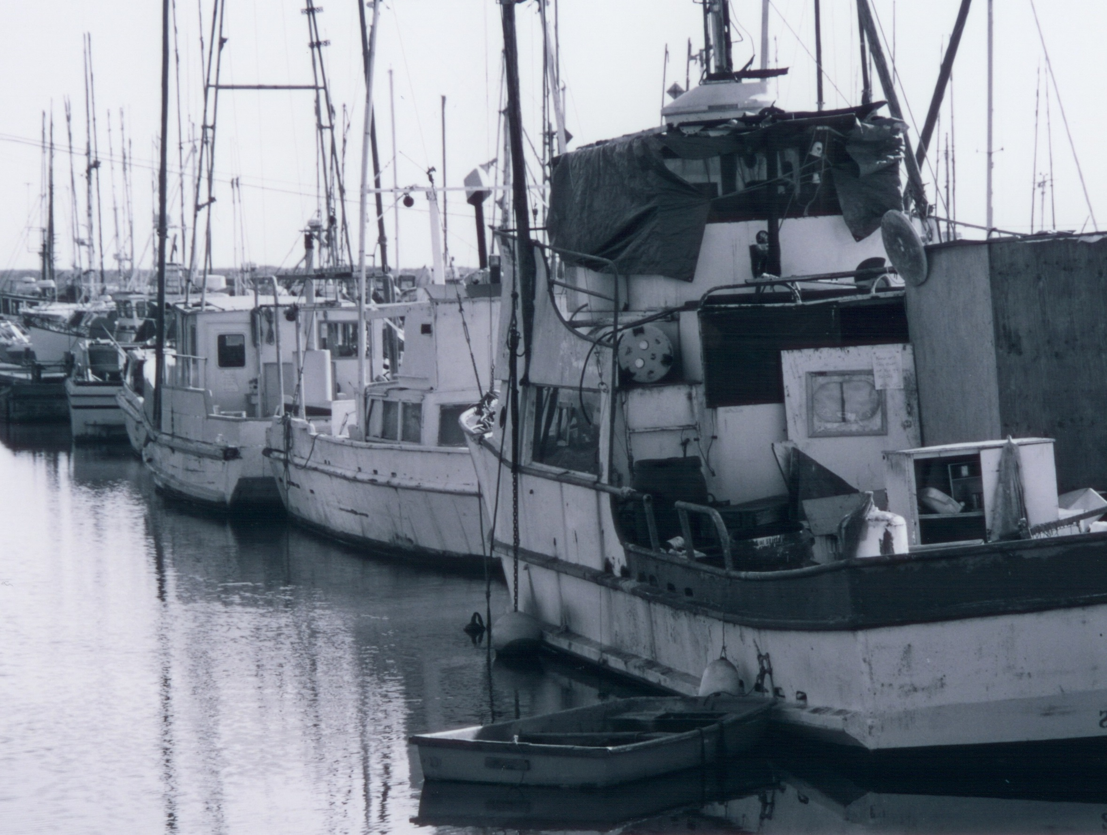

Slide 3
fishing practices are diverse on the west coast
troll
long line
bottom trawl
midwater trawl
pots
shrimp trawl
albacore
sablefish
whiting
crab
shrimp
chinook
lingcod
Ecology
mobile —> sedentary
pelagic —> benthic
vertebrate — > invertebrate
halibut
Gear
Mobile —> Fixed
Bottom —> Midwater
Selective —> Unselective
rockfish
Management
ITQs
TACs
Seasonal
Notes:
System is diverse, many gears, species targeted and types of management. Have…

Slide 4
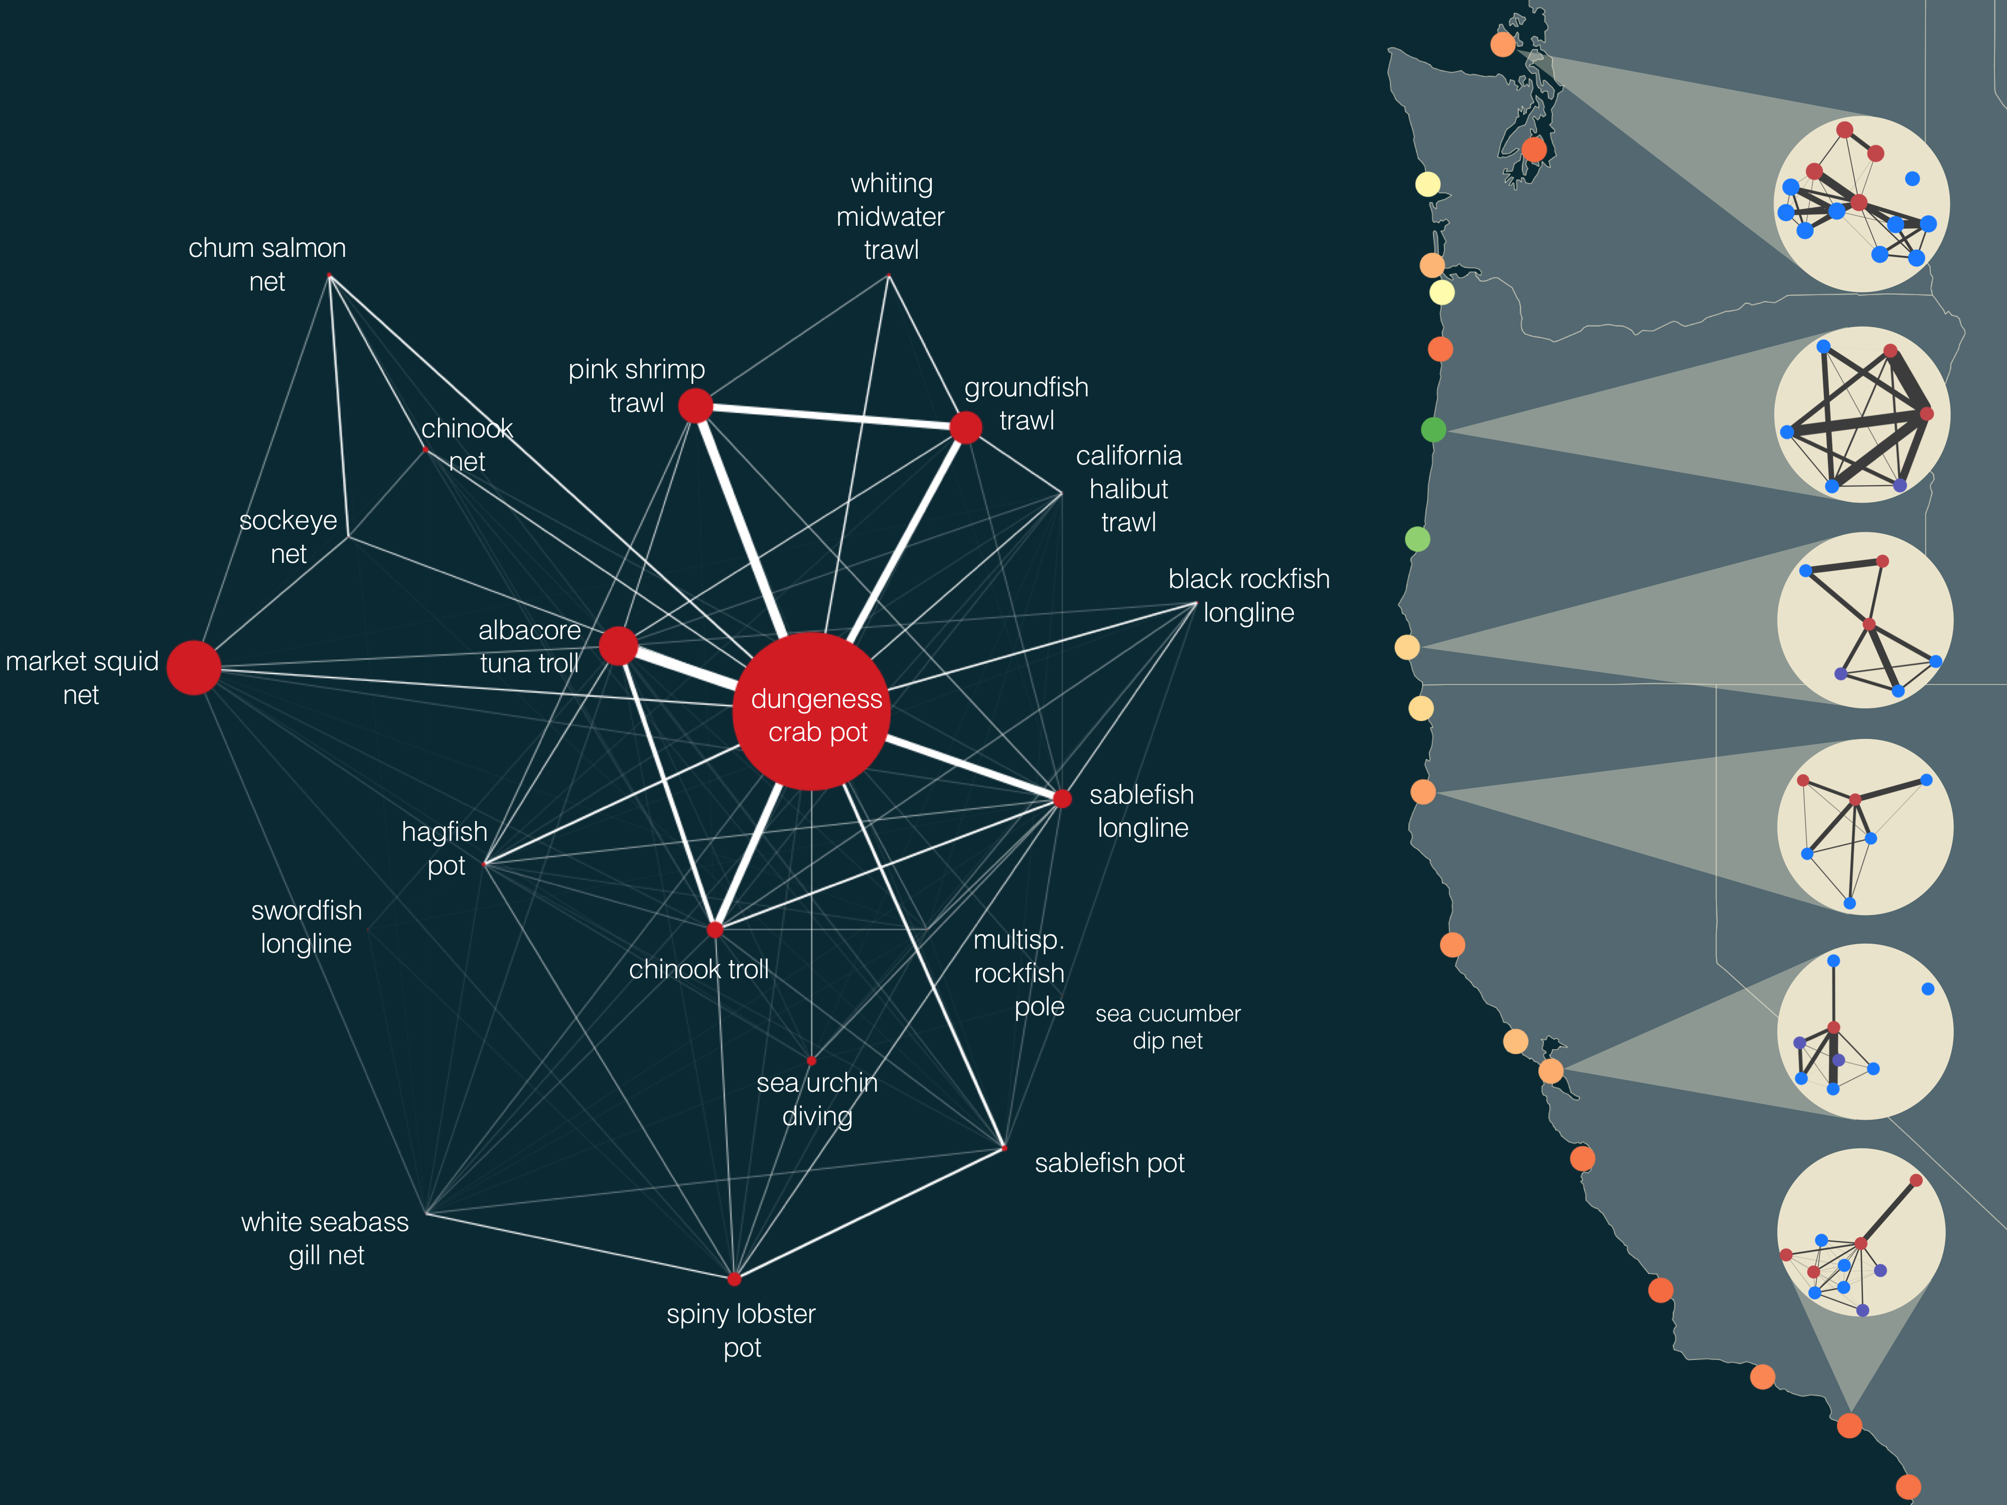
Fishing vessels are embedded within participation networks
NWFSC
The adaptive capacity of these networks varies from community to community
Pacific whiting
Notes:
Fig. 1. Human connectivity of commercial fisheries in the California Current Ecosystem. Fisheries in the California Current are strongly connected by human participation. Some fisheries, notably the Dungeness crab-pot fishery, dominate the coast-wide network. The human connections among fisheries also frequently connect ecologically distant species, i.e. Dungeness crab and albacore tuna or benthic groundfish and pink shrimp. Examining networks generated for port groups on the right, we find that these networks vary in the number of fisheries (nodes) and strength of interconnections. These differences in structure may correspond to differences in community resilience. We color ports using one potential metric of network resilience to highlight this heterogeneity (see supplementary materials for additional metrics). On the right port groups are colored by their adaptive capacity and show port-level participation networks with nodes colored by management jurisdiction (federally managed fisheries are blue, state managed are red, fisheries where both state and federal have a role in management, i.e. nearshore rockfish, are purple). For visual clarity we only include fisheries that had at least 3 vessels participating, and accounted for, on average, 25% of a vessel’s annual income (Materials and methods are available as supplementary materials at the Science website).

Slide 5
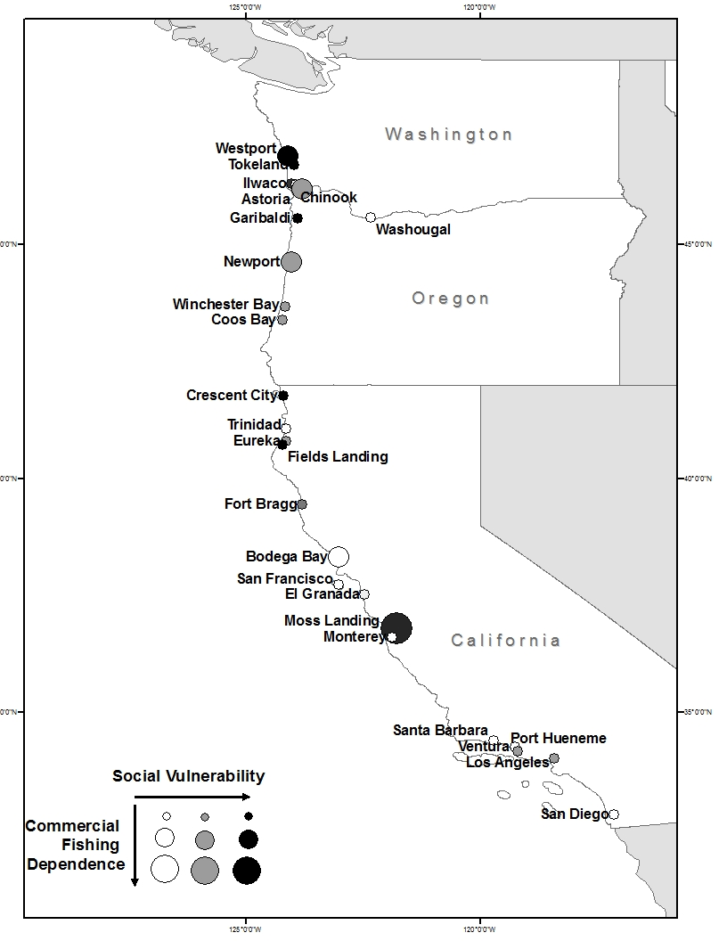

Slide 6
Placeholder for dummy network

Slide 7
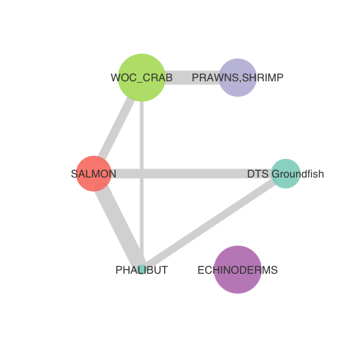
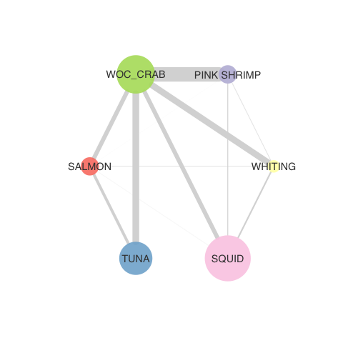
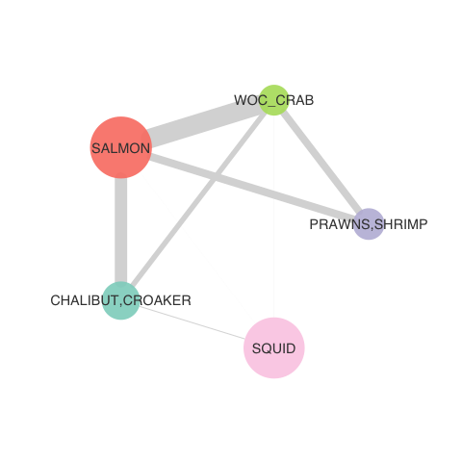
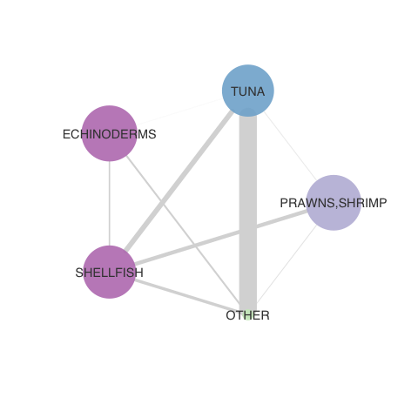
2019-2020 fisheries participation networks (by IOPAC port group)
North Washington Coast
Nodes: 6
Newport
Nodes: 6
Monterey
Nodes: 5
San Diego
Nodes: 6

Slide 8
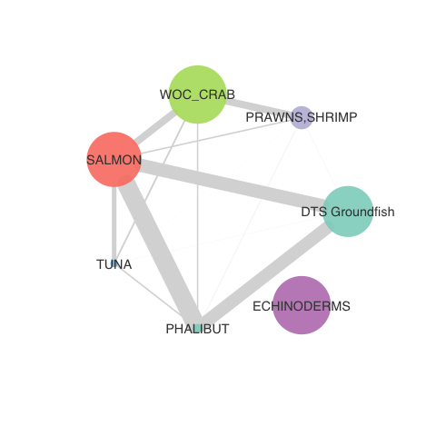
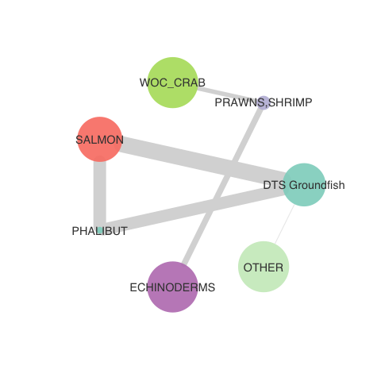
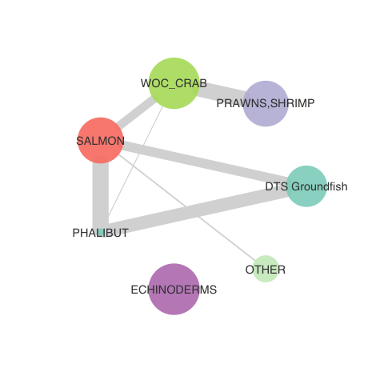
North WA Coast over time: less connected?
2016-17
2017-18
2018-19
2019-2020
Notes:
NEAH BAY, PORT TOWNSEND, PORT ANGELES, SEQUIM, LA PUSH

Slide 9
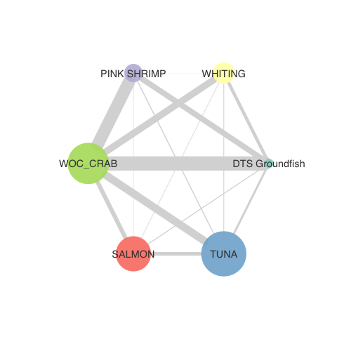
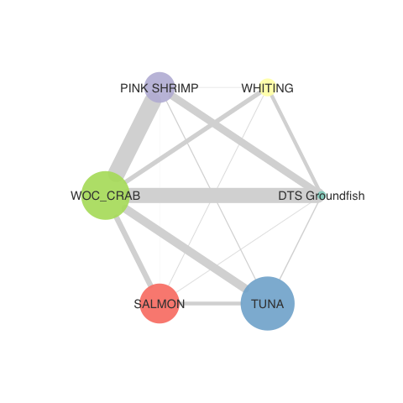
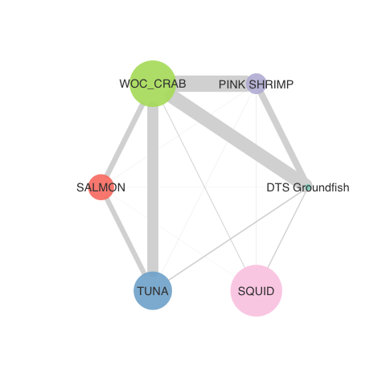
Newport over time: less connected?
2016-17
2017-18
2018-19
2019-2020
Notes:
DEPOE BAY, SILETZ BAY, NEWPORT, NEWPORT AREA PORTS, WALDPORT, YACHATS

Slide 10
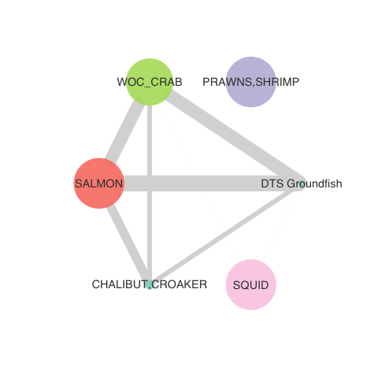
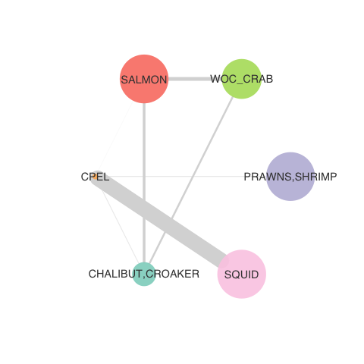
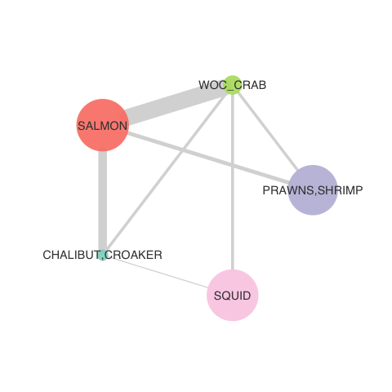
Monterey over time: variable?
2016-17
2017-18
2018-19
2019-2020
Notes:
BIG CREEK, SANTA CRUZ, OTHER SANTA CRUZ AND MONTEREY COUNTY PORTS, MOSS LANDING,
MONTEREY AREA PORTS, MONTEREY

Slide 11
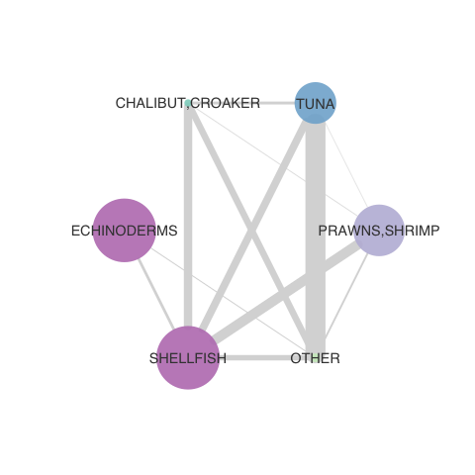
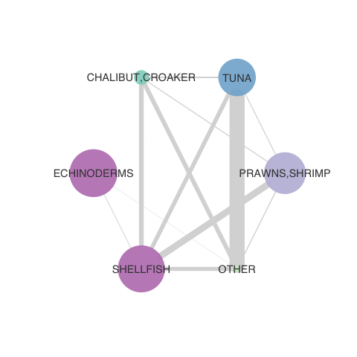
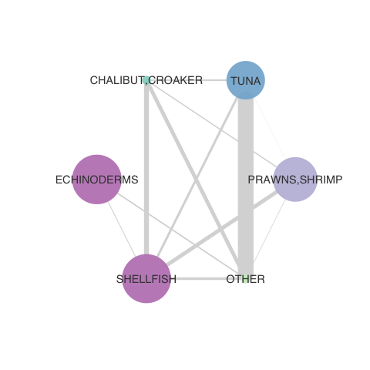
San Diego over time: consistent, ‘but?
2016-17
2017-18
2018-19
2019-2020
Notes:
OTHER SAN DIEGO COUNTY PORTS, SAN DIEGO, SAN DIEGO AREA PORTS, OCEANSIDE

Slide 12
 | High | Low
Node Count | 9 | 1
Edge Density | 1 | 0
Modularity | 1 | -1
Network Centralization | 1 | -1

